Slide 1
Python ML Workshop
ML101

Slide 2
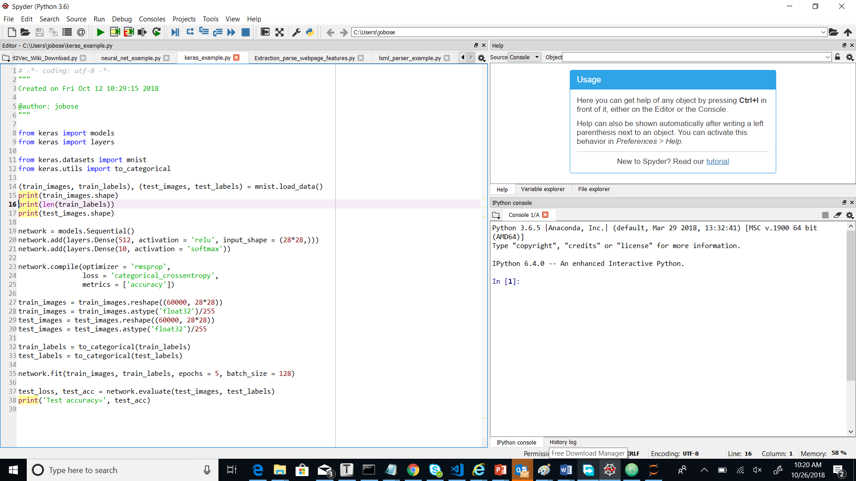
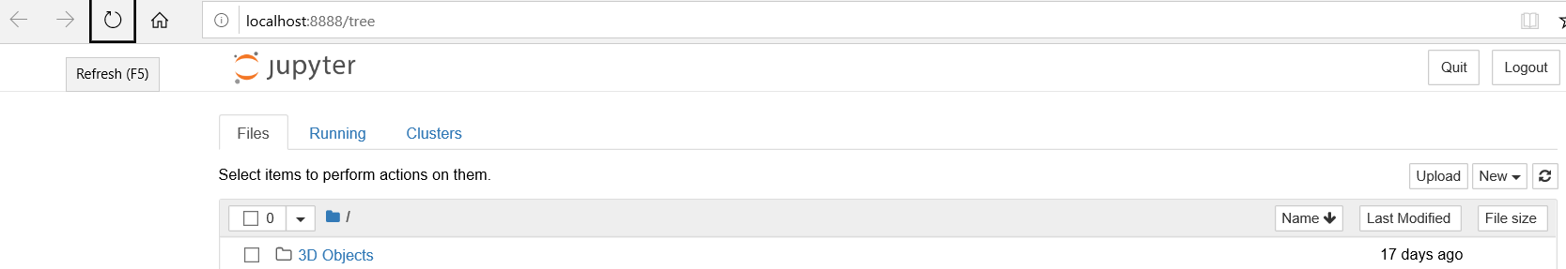
Setup
Install and setup Anaconda with Python 3 (Python installer, comes with set of packages) https://www.anaconda.com/download/
Make sure you can open Spyder and Jupyter notebook (from within anaconda, also can type it in search bar)

Slide 3
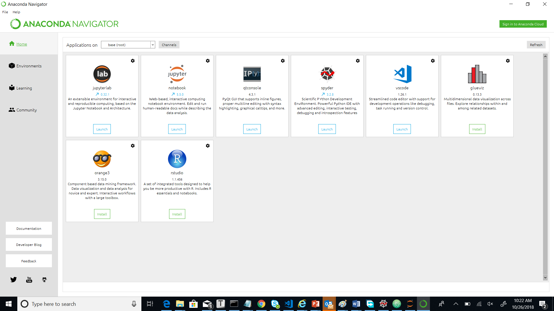

Slide 4
Open new Jupyter notebook
Simple Python program
print(‘hello world’)
Import libraries, datasets, visualization
Sample ML program
Text magic on a HTML file / URL

